Slide 1



Evaluating the Fairness of Bike Sharing Programs with Geospatial Analysis
Katelyn Morrison
Katelyn.morrison@pitt.edu
Notes:
Hello my name is Katelyn Morrison and I am a senior at the University of Pittsburgh. I have been investigating fairness within sociotechnical systems such as smart mobility. Recently, I evaluated the fairness of the bike sharing program in Pittsburgh using Geospatial Analysis.

Slide 2
Smart Mobility
On-demand mobility system
Bike Sharing Programs (i.e. Lime Bikes)
Car Sharing Programs (i.e. Zipcars)
Ride hailing Services (i.e. Uber, Lyft)
Dynamic; based on predicted demand
Reduce inner-city traffic congestion
Reduces air pollution
Notes:
I’d like to preface with a definition and examples of smart mobility.
Smart mobility includes mobility systems that are on demand and dynamic where their availability and frequency relies on predicted demand.
Some popular examples include bike sharing programs, car sharing programs, and ride hailing services.
Smart mobility programs are motivated to reduce traffic congestion which ultimately reduces air pollution, increases quality of life, and provide affordable, accessible transportation.

Slide 3
Smart Mobility & Accessibility
Systems require smartphone or credit card
Station locations are not distributed evenly [1]
Near bike trails
Near upper- and middle-class neighborhoods
Access to transportation leads to access to the job market
[1] Stephen J Mooney, Kate Hosford, Bill Howe, An Yan, Meghan Winters, Alon Bassok, and Jana A Hirsch. Freedom from the station: Spatial equity in access to dockless bike share. Journal of transport geography, 74:91–96, 2019.
Notes:
Many smart mobility programs have been implemented within cities to broaden the possible modes of transportation, but these programs require users to have a smart phone and sometimes even debit/credit card account.
It has also been observed by several studies that many of the offerings offerings are not distributed evenly. For example, these smart mobility systems are near bike trails for recreation or near upper and middle class neighborhoods.
The even distribution and fairness of offering these modes of transportation are imperative to providing all social classes access to the job market.

Slide 4
Definition of Fairness for Smart Mobility Systems
”
“
…individuals of different demographic groups receives equal amount of mobility resources
Yan, An, and Bill Howe. "Fairness-Aware Demand Prediction for New Mobility." Proceedings of the AAAI Conference on Artificial Intelligence. Vol. 34. No. 01. 2020.
Notes:
Considering fairness within a smart mobility system in cities – An Yan and Bill Howe from the University of Washington state fairness in their recent publication as the requirement that individuals of different demographic groups receives equal amount of mobility resources

Slide 5
Evaluating Fairness
Percentage of Poor Housing Conditions by Census Tract
“Percent of residential buildings that are in poor or worse condition" (WPRDC)
Number of stations in each Neighborhood (or Census Tract)
Capacity of each bike station
Notes:
In my case study of the bike sharing program within Pittsburgh, I evaluated fairness by using three features. The first was the percentage of poor housing conditions which is the percent of residential buildings that are in poor condition, the second was the number of bike stations in each neighborhood, and the third was the capacity of each bike station.

Slide 6
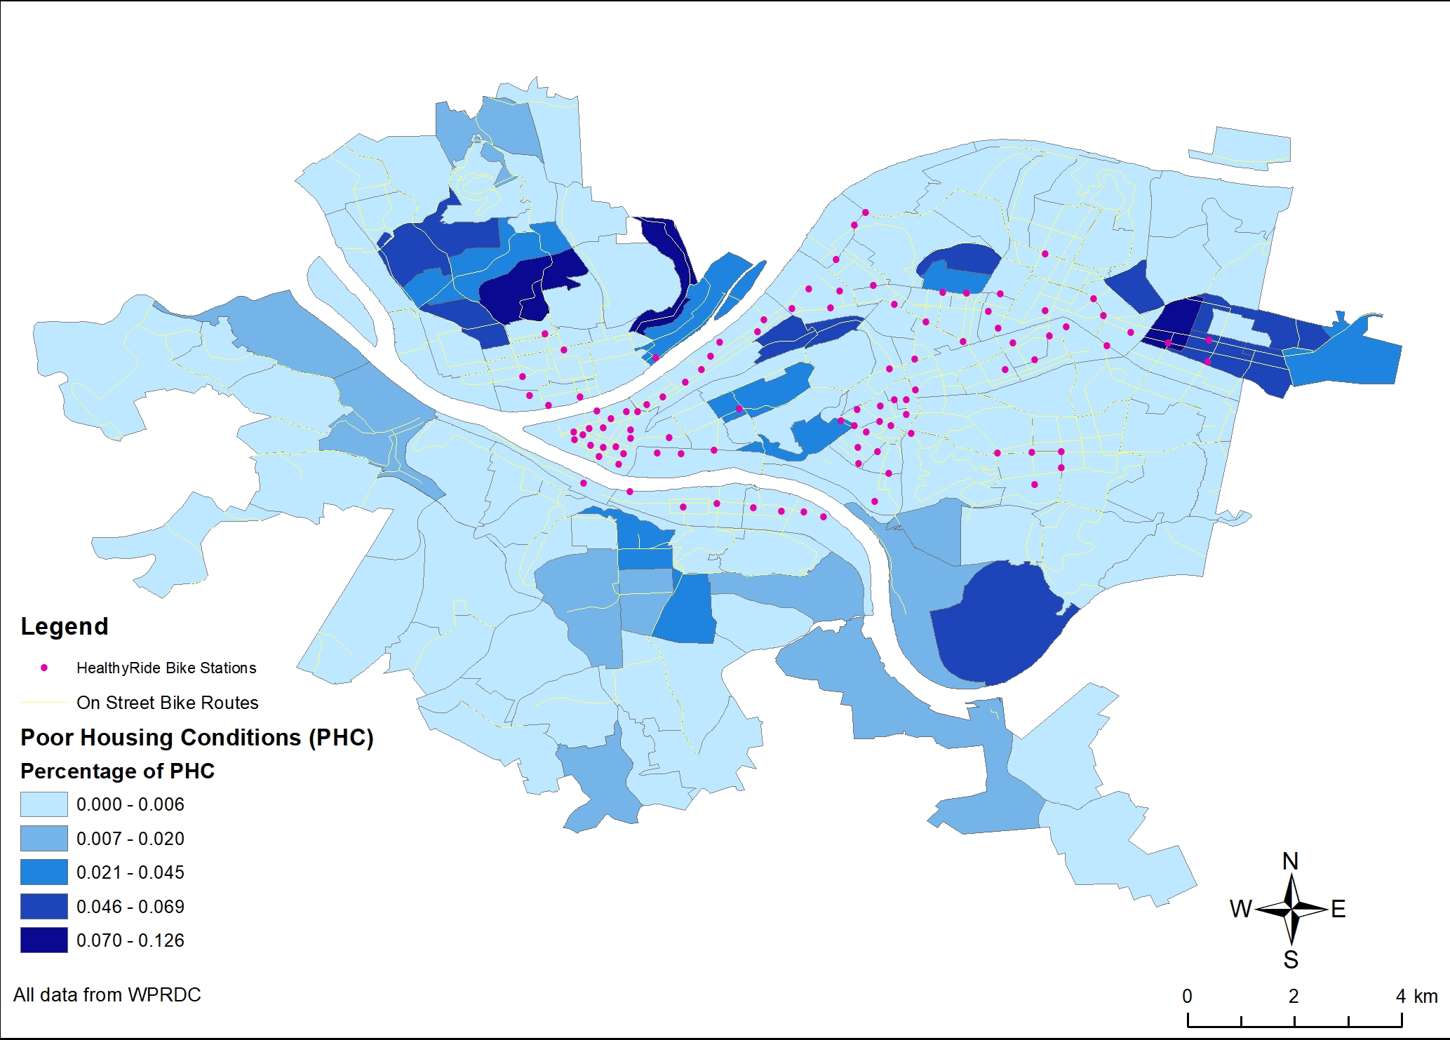
Mapping station locations to Poor Housing Conditions
Capacity: 5 bikes
Capacity: 12 bikes
Capacity: 6 bikes
Capacity: 15 bikes
Pitt & CMU
Downtown
Notes:
The locations of bike stations are presented by pink dots. The percentage of poor housing is in a shade of blue. First observation made is the huge grouping of stations downtown and along the strip district. The next observation shows a lot of bike stations surrounding Pitt and CMU’s campus. More importantly, you can clearly see the neighobordhoods with poor housing have very few bike stations. Despite on street bike routes running through the neighborhood. Out of the 100 bike stations only 5 of them are in neighborhoods with a poor housing conditions. That means that only 5% of the resources are located in low income neighborhoods.

Slide 7
Conclusions & Future Work
Exploring new locations to place bike stations [1]
Bayesian Optimization
Exploration vs. Exploitation
Identifying how to reduce discrimination in the algorithm pipeline
Predicting Demand
Prime Locations
[1] UNDER REVIEW: Katelyn Morrison. Reducing Discrimination in Learning Algorithms for Social Good in Sociotechnical Systems. 2020.
Notes:
In the future, planners of bike sharing programs, and smart mobility systems in general, should try to explore more regions that they have not before. This opens the doors for potentially using Bayesian optimization as the program planners are put in an exploration vs exploitation problem when determining where to distribute mobility resources that will result in a lot usage.
Overall, challenges such as predicting demand of the station, and identifying locations while reducing discrimination should continue to be researched in the future to improve traffic congestion and balance the accesibility of these vital resources amongst social classes.

Slide 8
Thank you!
Evaluating the Fairness of Bike Sharing Programs with Geospatial Analysis
Katelyn Morrison
Katelyn.morrison@pitt.edu
Notes:
Thank you! If you have any questions or are interested in collaborating please email me or message me in the slack

